Slide 1

THE ROLE OF DATA SCIENCE IN AUDITING AND PUBLIC ACCOUNTING
P R E S E N T A T I O N
slide
1

Slide 2

Introduction
Data science is transforming auditing and public accounting by improving accuracy, efficiency, and fraud detection. This presentation explores key roles, challenges, and success stories.
Slide 2

Slide 3
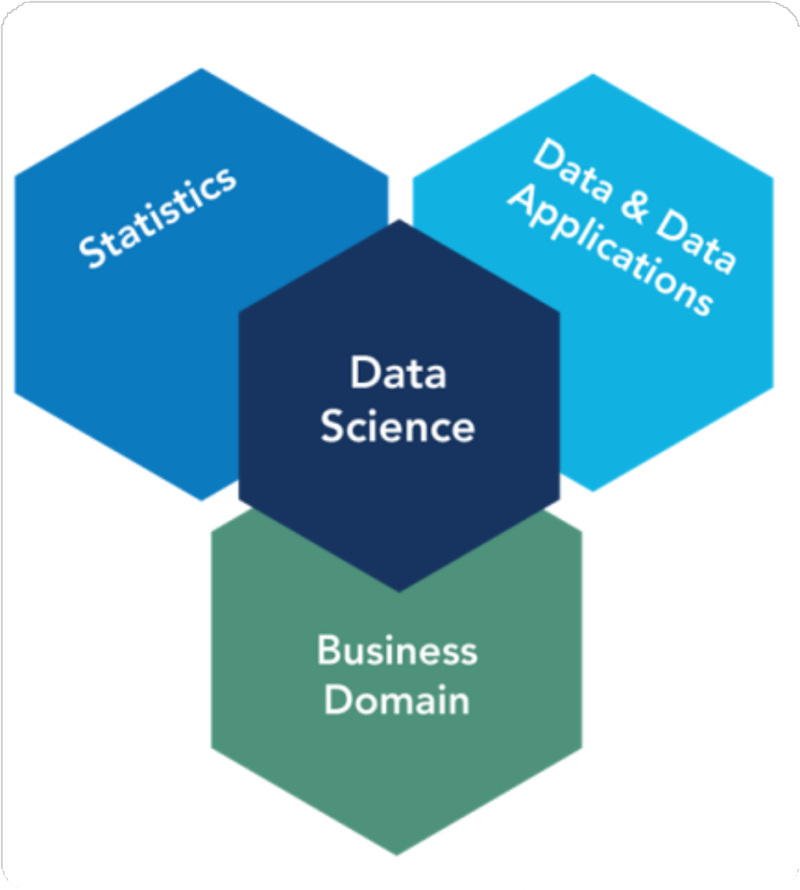
Key Data Science Roles in Auditing

Slide 4
1. Data Analysts – Process and analyze financial data.
2. Data Engineers – Manage data pipelines and infrastructure.
3. Machine Learning Specialists – Develop models for fraud detection and risk assessment.
4. Audit Data Scientists – Use data-driven insights to enhance audit quality.
5. AI & Automation Experts – Implement AI-powered solutions for audit efficiency.
Slide
3

Slide 5

Data Challenges in Auditing

Slide 6
Data Quality – Inconsistent, incomplete, or inaccurate financial data.
Data Privacy & Security – Ensuring compliance with regulations (e.g., GDPR, SOX).
Integration Issues – Combining multiple data sources from different systems.
Interpretation of Complex Data – Ensuring insights are actionable and relevant.
Adoption Resistance – Overcoming reluctance to use AI and automation in audits.
Slide

Slide 7

Data-Driven Success Stories

Slide 8
KPMG – Leveraged AI-powered auditing tools to detect anomalies in financial records.
Deloitte – Implemented machine learning to anticipate and assess risks in audits.
PwC – Utilized big data analytics to enhance audit precision and strengthen fraud detection.
EY – Combined blockchain technology with data analytics to enhance transparency in financial transactions.
BDO – Adopted automation to streamline audit processes and improve operational efficiency.

Slide 9
KPMG has integrated advanced artificial intelligence (AI) tools into its auditing processes to enhance accuracy, efficiency, and fraud detection.
Key Aspects of KPMG’s AI-Driven Auditing Approach:
Anomaly Detection
Natural Language Processing (NLP)
Predictive Analytics
Automation of Routine Auditing Tasks
Enhanced Fraud Detection
Real-time Insights
By implementing AI in auditing, KPMG enhances audit quality, reduces human error, and strengthens compliance measures, ensuring a more transparent and reliable financial review process.

Slide 10



Conclusion
Data science is revolutionizing auditing and public accounting by improving accuracy, detecting fraud, and enhancing efficiency. While challenges exist, firms that leverage data science effectively gain a competitive advantage in financial audits.
Slide 6

Slide 11
THANK YOU
F O R Y O U R A T T E N T I O N
Slide
7

